Slide 1
Unified Communications e soluzioni cloud
ProCall 6 Enterprise, i servizi cloud UCConnect e la serie ECSTA 5
ProCall 6 Enterprise
UCConnect
ECSTA 5 Serie
Notes:
We will inform you about the topic of Unified Communications with estos in this lecture, which is scheduled for 45 minutes. We will concentrate on the latest version of the Unified Communications & CTI software suite ProCall 6 Enterprise, as well as the middleware series ECSTA, which can be combined with the PC. In addition, we will also present the new hybrid cloud building blocks that estos has added to their portfolio this year, enabling companies to put certain functions of ProCall Enterprise, such as communications across the company’s website, much more easily. We will also provide you, if appropriate, the context of possible marketing approaches in some places, so that you can communicate directly with your customers.

Slide 2







Computer Telefony Integration
(CTI)
Unified Messaging
(UMS)
Dal 1997
Dal 1994
Notes:
First, briefly some information about estos, for those who do not know the company. estos GmbH is an independent software producer, and has existed since 1997, becoming a major player in the area of CTI. Today, the company develops professional unified communications software and offers a broad portfolio of products to help small and medium-sized companies, as well as international corporations, improve their communication and collaboration with partners, suppliers and customers internally and across company boundaries. In 2016, estos acquired the company serVonic, with whom they had a close co-operation for years. That is why estos can now cover the topic of Unified Messaging, i.e. software for fax, voice and SMS, optimally in-house, since serVonic has been active in this area since 1994. Companies that choose estos do not only opt for long-term know-how, but also for a development location in Germany, i.e. for software ‘Made in Germany’, which is safe and oriented for the future.

Slide 3


Funzioni Softphone (SIP)
***NEW
Notes:
The most important new innovation at ProCall 6 Enterprise is the softphone functionality. Users can decide whether they want to use a normal ‘classic’ telephone or a headset directly from the PC. We supply two lines, the customer has the choice. Two SIP lines, a SIP line and a classic, or two classic telephone lines, if they want to do without the softphone function. Currently the softphone functionality has already been tested on a number of PBX telephone systems, such as OpenScapeBusiness, MitelMiVoice400, MitelMX-ONE, Panasonic KX-NS and the Panasonic NSX series. Further PBX systems are currently being tested. An overview of the successfully tested telephone systems can be found in the latest release notes.

Slide 4




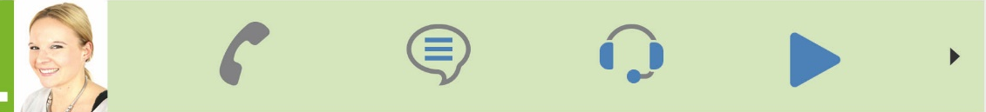
Presence Management
Instant Messaging
Audio/Video Chat
Collaboration
(Desktop Sharing)
Ecco un esempio della barra “quick start”
Notes:
Here you can see, for example, the so-called "quick start bar“. If you activate a contact with the mouse in your favorites, this short menu will open automatically. You can see by the color of the contact to the left of the image – as in this case green – their respective availability, which estos calls presence management. You can also perform an action on this contact. Depending on the order displayed, you can call the contact directly, send them a text chat, start a pure audio chat or an audio/video chat. In addition, ProCall Enterprise also offers the possibility to view and work with documents together via screen sharing. Depending on the present situation, a user can always choose the communication channel that appears appropriate to them.

Slide 5
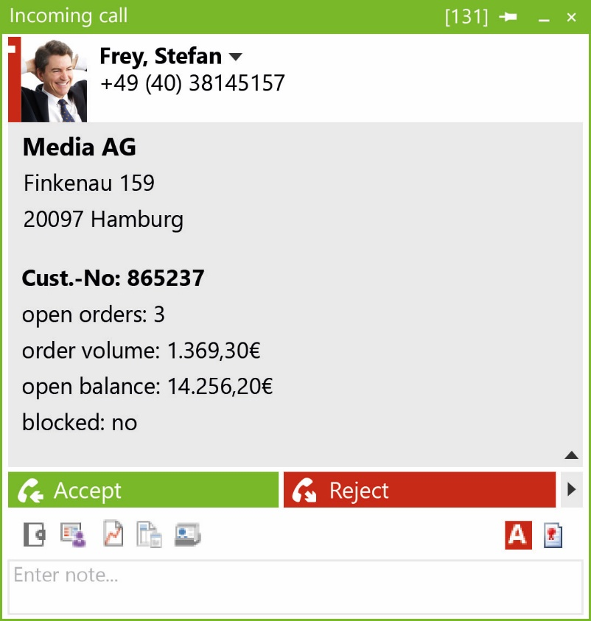
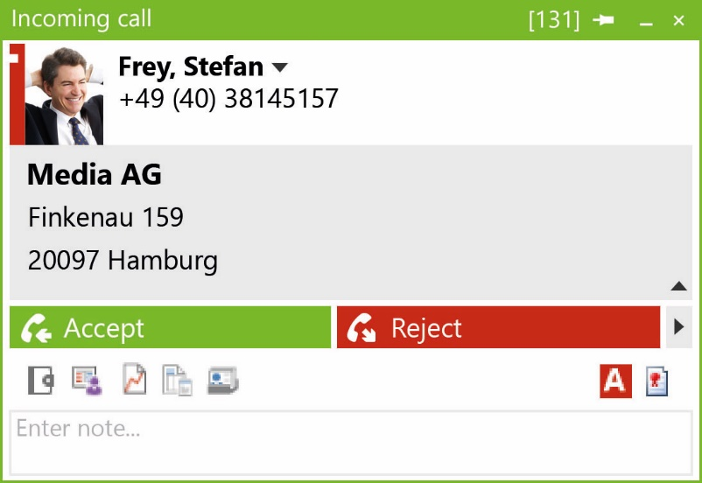

Integrazione ai processi produttivi (CEBP)
Notes:
An interesting and often underestimated opportunity for companies is the topic of business process integration. But what lies behind this term? It is about linking a communication solution with CRM, ERP or special industry programs already being used by the customer. Instead of bringing another solution "into the house" with the communication solution, the leading application, such as an SAP or DATEV pro, is linked to the communication application. What are the advantages for a company? An employee sees, for example, directly at the start of the call, who the caller is and already has additional valuable information that might be relevant to the call . There are different stages of business process integration. In the left screenshot you see the so-called "entry option", if only an address book, for example, the Phone Book Germany. On the right you can see how a comprehensive business-process integration can look. As an employee, I can see important information relevant to my conversation and can initiate further action with just one click. For example, I can decide to make a new order immediately at the request of the customer.

Slide 6
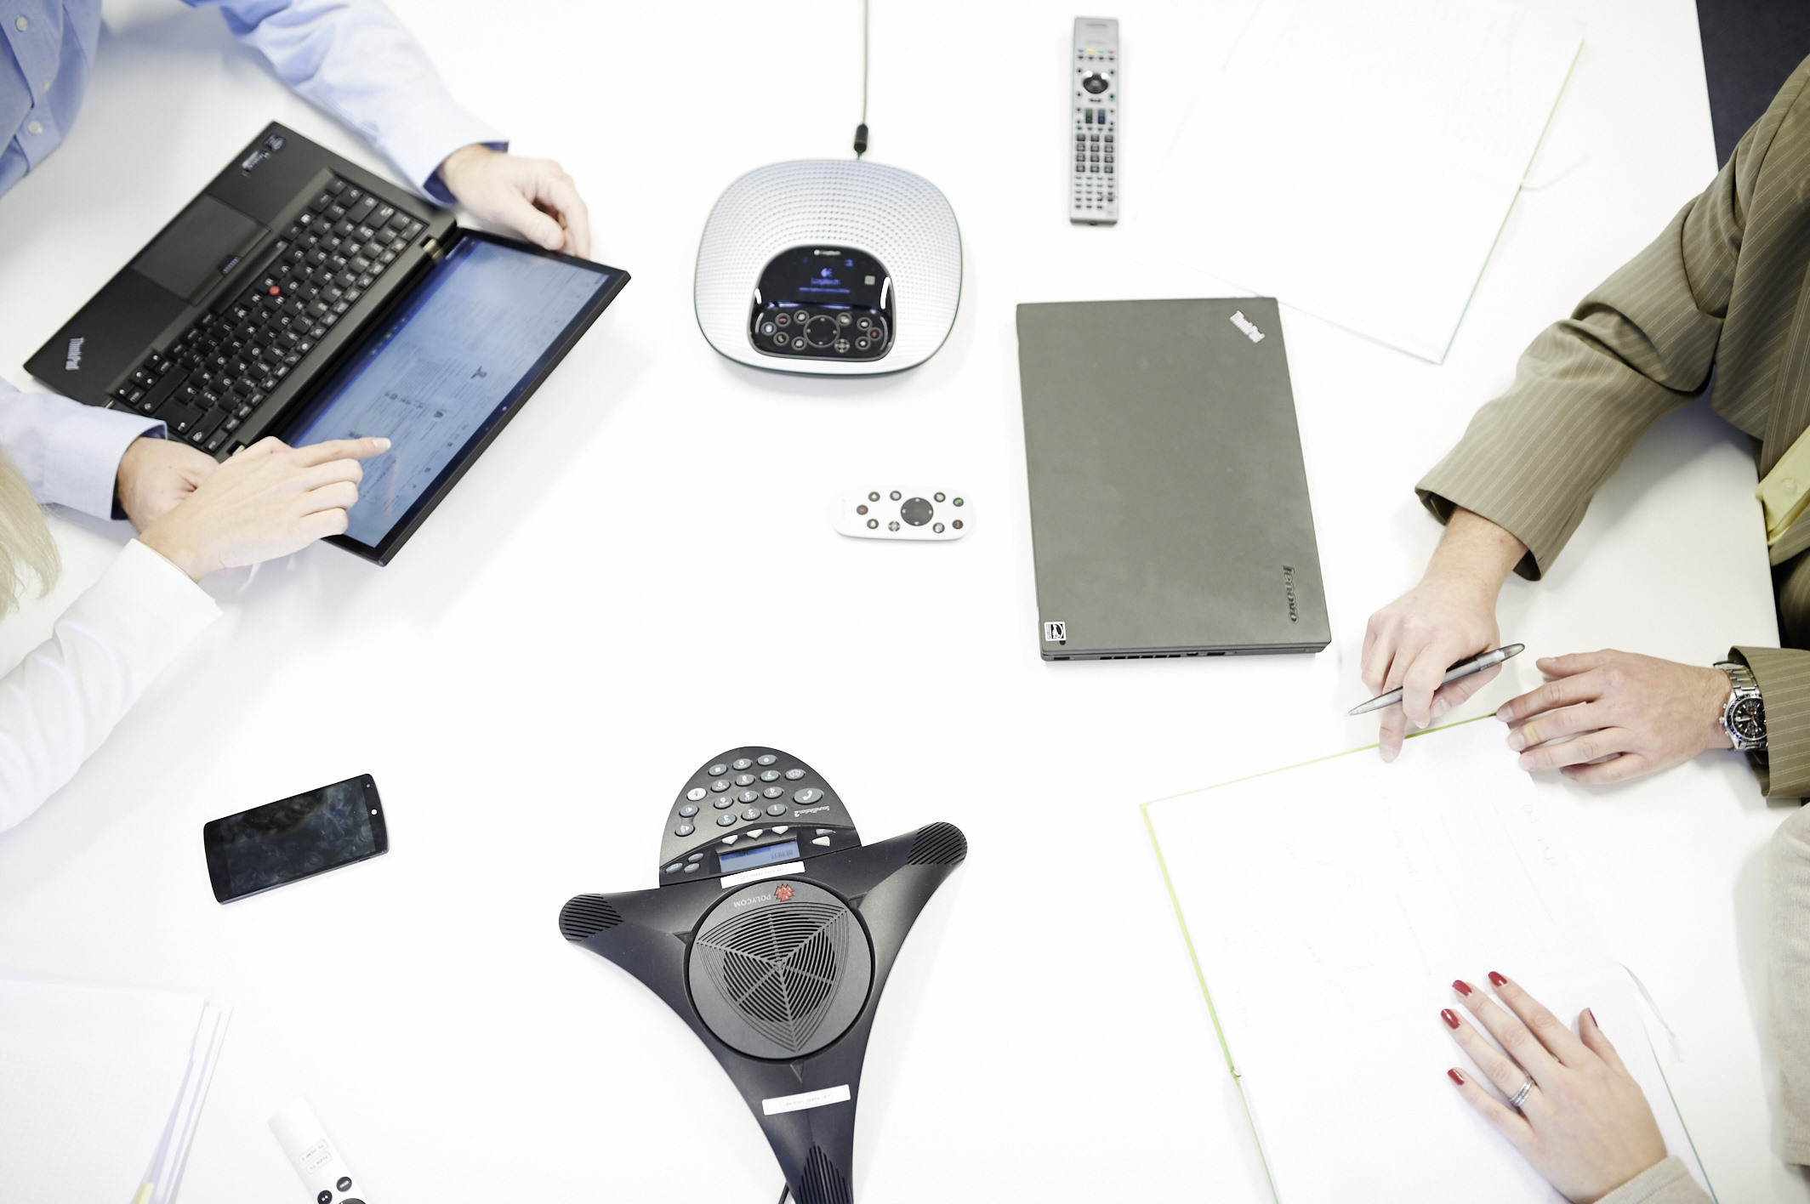



Multi-vendor
Multi-site
Multi-device
Notes:
Three other essential advantages are offered by the estos software: Multi-vendor, multi-site and multi-device. Thanks to multi-vendor technology, lines of different communication systems – either the same or different types – can be used in one application. Thus, a company can maintain its own various telephone systems. The telephone systems are connected to one and the same UCServer via the professional CTI & TAPI middleware ECSTA. Multi-site technology allows multiple sites to be linked to the same UCServer. For example, presence and contact information can be viewed across different company locations. In this way, employees working at various sites are better informed about the best way to contact other colleagues. Multi-device means, ProCall Enterprise can be platform-independent and device-spanning, and also provides native clients for macOS, iOS and Android. ProCall Enterprise takes account of the demands of today's mobile workers. Users can use ProCall Enterprise at a classic PC workstation as well as on a mobile via the app.

Slide 7


Federation
Notes:
Federation offers an opportunity for companies to network with their partners, suppliers and customers, beyond their own company’s boundaries. Federation is a modern Internet networking concept for organizations based on open standards and secure protocols. Within the framework of a "trusted network" in a federation, employees of "friendly" companies can then exchange relevant data easily. The decision as to which information to share with the other company can be made on an individual basis. Through federation, companies have the advantage that they can see presence information easily and, if necessary, can quickly exchange text chats.

Slide 8
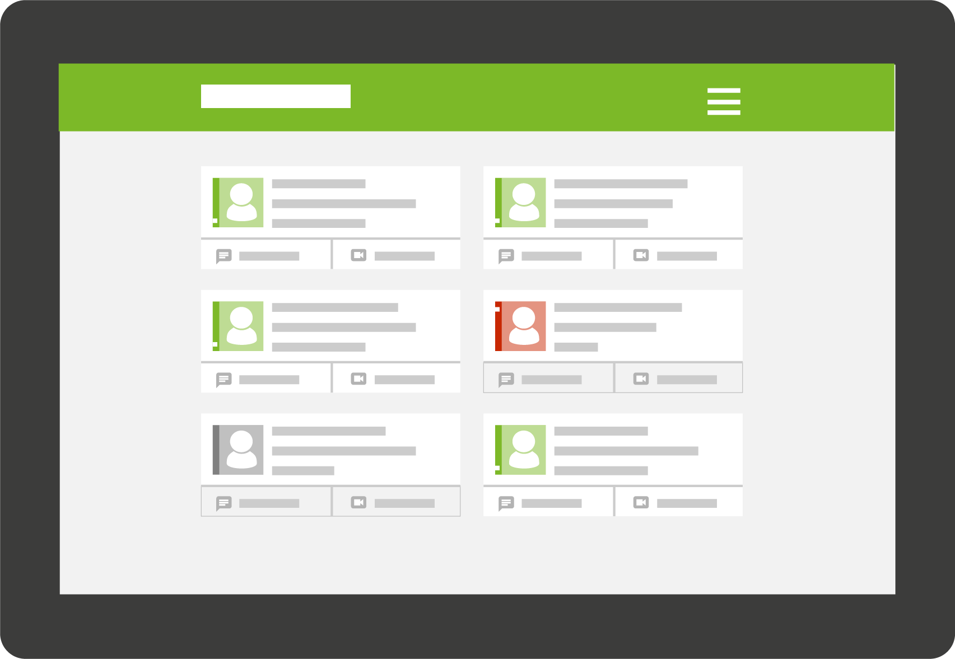

Contact portal/Multimedia business card
***NEW
Notes:
In addition to the softphone functionality of ProCall 6 Enterprise, the contact portal and multimedia business card components are also new. What does this mean? With ProCall Enterprise, companies get the technical principles to offer real-time communication through their company website for prospective clients and customers. With the contact portal, for example, companies can make selected employees visible and "contactable" from "outside“. In the case of a bank, it would therefore be conceivable to make consultants’ availability known with presence management and visible via the contact portal of their own website, so that a customer can reach his personal advisor easily via text, audio or audio/video chat. The multimedia business card works similarly. Every employee with a multimedia business card can insert it as a link directly into an e-mail. Thus, appointments between the consultant and the customer can be made comparatively easy. The multimedia business card works like a web page. In addition to the image of the contact person, his presence, as well as the different contact options are listed. Both options – contact portal and multimedia business cards – offer companies in all industries a comparatively simple way to allow visitors to their website a direct, uncomplicated means of contact. Therefore, the website changes from a pure information medium to a platform for communication and interaction.

Slide 9

ProCall 6 Enterprise
Unified Communications & CTI Software Suite
Notes:
So now we come to the most important innovations around ProCall 6 Enterprise, the Unified Communications & CTI Software Suite. With ProCall Enterprise, companies are able to improve their communication and collaboration internally as well as externally. By the way, UC stands for Unified Communication, which means that the originally separate communication worlds of PC and telephone now flow together in a single application. This makes communication-intensive processes easier for companies. Employees’ daily work steps are simplified, for example, by eliminating the manual inputting of telephone numbers. Thereby, sources of error are simultaneously minimized.

Slide 10
Cosa c‘è di nuovo in ProCall 6 Enterprise?
  Contact portal e biglietto da visita multimediali per il vostro sito web
  Funzionalità softphone (per PBXs con interfaccia SIP)
    Disponibile per il client Windows client e per le app mobile Android e iOS
  Funzionalità agente per specifici PBX (es. login/logoff gruppo)
  Integrazione G Suite (ex Google Apps for Work)
    Integrazione a contatti e calendario
  Supporto nativo a ixi-UMS Business/Enterprise (FAX/UMS)
  Supporto a Microsoft Windows Server 2016, SQL Server 2016
  Supporto al software Plantronics Hub Headset
Notes:
The major innovations in ProCall 6 Enterprise include:
The contact portal and multimedia business card for websites
Softphone functions for selected PBXs as an SIP subscriber connection
The softphone functions are available in the Windows desktop client and smartphone apps. The Mac client has not integrated any softphone functions, and will not in the foreseeable future
With the agent function, users can log into the call group of selected PBXs or switch to ‘post processing’ (call wrap-up). The equipment is installed in the PBX. We are currently supporting the Panasonic NS-NS(X) PBX telephone systems
Also new, is the support of Google G Suite contact data and calendar
ixi-UMS Business/Enterprise can be optionally integrated into ProCall Enterprise. Integration takes place via the Custom tab in the ProCall Windows desktop client. Single-sign-on is supported. Of course, you can also integrate any other UMS solution of your choice with ProCall Enterprise

Slide 11
Cosa è stato migliorato?
  Smartphone Apps per Android e iPhone completamente ridisegnate
  Client macOS ¹⁾ completamente ridisegnato con supporto a macOS Sierra
  Integrazione voce via Bluetooth in aggiunta al controllo dello smartphone
  Chat di gruppo, conferme di lettura, supporto standard emoji
  Ordinamento journal per contatto
  UCServer è ora un‘applicazione a 64-bit
¹⁾ Ora in fase “Public Beta”, disponibilità entro 12/2017.
Notes:
ProCall 6 Enterprise has also implemented numerous improvements:
The smartphone apps have been completely redesigned and are available for installation under the new name "ProCall6 Mobile" in the Apple iTunes App Store and Google Play Store. The requirements have been revised. Changes to the system architecture have also significantly improved the reliability and response speed of the apps
The Mac client has also been completely revised. Here, too, the technology was put on a new basis
A Bluetooth link between a mobile phone and the Windows workstation has been enhanced by audio support, i.e. for telephone calls which are routed via the GSM mobile phone, a USB headset connected to the Windows workstation can be used. The CTI control of the mobile phone and the integration of particular telephone books remain
The chat function has now gained send and receive confirmation in the form of checkmarks. The chat can now also be extended for additional participants. The visual look has been updated
The telephone and chat journal can now be separated between chronological (default) and user-centered sorting. User-centered sorting improves productivity by enhancing the overview in the journal
The UCS server from ProCall 6 Enterprise is now only available in a 64-bit version, since support for all Microsoft 32-bit operating systems has been discontinued

Slide 12
Cosa non è più supportato?
  Supporto a SPEXBOX di SPEECH EXPERTS (FAX)
  Integrazione Tobit David
  Pianificazione chiamata su app mobile
  Variante ProCall Mobile per iPad
Notes:
We have also removed features from ProCall 6 Enterprise, which were available in earlier versions. These are:
Integration of the SPEXBOX fax solution from SPEECH EXPERTS has been removed
Tobit David support is no longer available
Call scheduling was removed in the apps
In addition, the iPad variant was replaced by the iPhone variant, which now automatically adapts to the device size

Slide 13
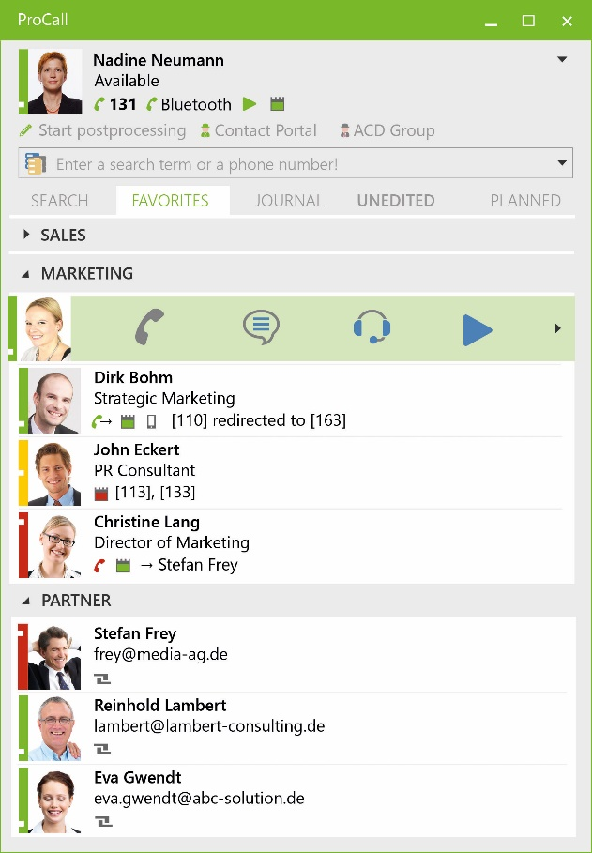
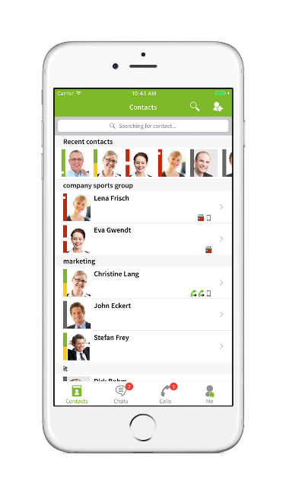

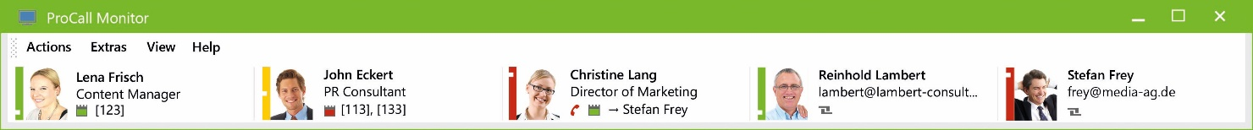
ProCall 6 Enterprise Software Suite (CTI & SIP)
CTI per smartphones e cellulari con supporto bluetooth
Funzionalità Softphone
(SIP)
Finestra di chiamata (CTI)
Utente in
mobilità
(App per iOS
& Android)
Notes:
Let's take a closer look at the ProCall Enterprise Client. What can the user see?
First, you will see the ProCall client in the large central screenshot. We see the example from Nadine Neumann
In addition to the classical telephone line, a mobile phone is also connected via Bluetooth. This is how the mobile phone journal and contact details are integrated into ProCall
Below, the favorites are displayed, sorted by departments and with various additional information
For the contact Dirk Bohm, you can see, for example, that he is on the road and is connected via his app
Christine Lang is currently talking via the integrated softphone function (SIP) with Stefan Frey. That is why, alongside Christine Lang, the small red telephone handset appears
Whether you are calling for by telephone or audio/video chat: in the call window you can find information about the call partner depending on the individual design of the business process integration on your CRM, ERP or industry programs. Here is the example of a call window (CTI) for a telephone call. From the call window, you can also trigger actions in your CRM/ERP or industry solution, or automatically save information from the note (memo) field
If an employee uses the ProCall Mobile smartphone app for iOS & Android on the road, the smartphone symbol appears, as shown by the example of Dirk Bohm
An additional display option is the ProCall Monitor, which you see at the bottom. It can be pinned to any position on the PC screen and always shows contact availability at a glance. The monitor can be set up in addition to the client

Slide 14
Funzionalità softphone disponibili
Attuali:
Avvio chiamata
Termine chiamata
Rifiuto chiamata
Composizione toni DTMF
Pianificate:^{*)}
Messa in attesa
Chiamata di consultazione
Trasferimento
Switch chiamate
Conferenze a tre
Impostazione/modifica deviazioni
*) disponibile in fase closed beta dal 02/10/2017.
Notes:
Here you can see selected SIP softphone functions. You can see all functionalities which already work smoothly on the left under "Current“. On the right, you will see the planned functionalities, which will also be supported in the future. Please note: Planned functionalities means that estos is still carrying out comprehensive tests.

Slide 15
PBX Supportati – Connessione SIP
Attuali:
Unify OpenScape Business
Mitel MX-One
Mitel MiVoice Office 400
Panasonic KX-NS(X) Series
Standard SIP (su richiesta)
Pianificati:^{*)}
Alcatel OmniPCX Enterprise
Unify OpenScape/HiPath 4000
Avaya IP Office
Innovaphone
Auerswald
BroadSoft BroadWorks Cloud PBX
*) disponibile in fase closed beta dal 02/10/2017
Notes:
The same breakdown is shown here for selected telephone systems. The connection is made in SIP subscriber interface (SIP TN). On the left are those that have been successfully tested previously, and on the right all the telephone systems which are planned to be supported in the future, but are currently still in the test phase.

Slide 16
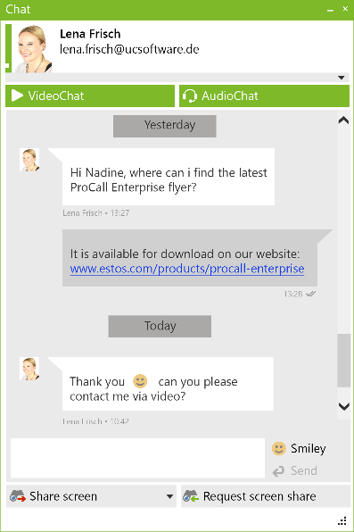
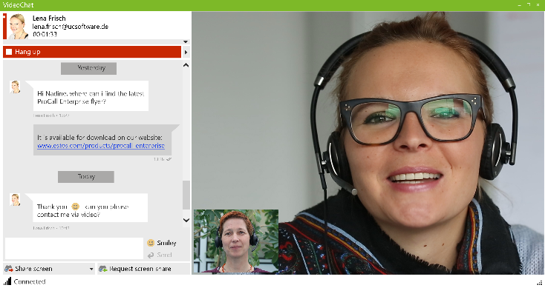
ProCall 6 Enterprise Software Suite (Chat & Collaboration)
CTI per smartphones e cellulari con supporto bluetooth
Instant Messaging
VideoChat (WebRTC)
Collaboration (Desktop sharing)
Funzionalità
Softphone (SIP)
Finestra di chiamata (CTI)
Utente in
mobilità
(App for iOS
& Android)
Notes:
Here we see again the current client:
In the upper left corner, you can see the screen shot of a new chat (instant messaging), with receipt & read confirmation shown with two green checkmarks. The smiley selection was also expanded
A video chat (WebRTC) or collaboration (desktop sharing) can be started from the chat window as well as directly from the "quick start bar" to the contact
Video chat is also supported in the smartphone apps for iOS and Android

Slide 17
ProCall 6 Enterprise Software Suite (CEBP & Federation)
CTI per smartphones e cellulari con supporto bluetooth
Instant Messaging
VideoChat (WebRTC)
Collaboration (Desktop sharing)
Funzionalità
Softphone (SIP)
Finestra di conversazione (CTI)
Utente in
mobilità
(App for iOS
& Android)
Integrazione ai
processi produttivi
(CEBP)
Federation
Notes:
Two other components of the client are the possibilities for an integration for business processes (CEBP), and networking beyond the company’s borders via federation.
As already mentioned in the call window (CTI) to Stefan Frey, additional valuable information about the contact is displayed, depending on the integration
This can be, for example, information from any connected telephone book, so at least the name and place is displayed from an unknown caller
If, in addition, CRM, ERP or other industry programs (e.g. DATEV pro workplace) are connected, you can also see the number of open orders, for example, when the customer/client was last in the garage with his car for inspection or what products he has not bought yet. The displayed information can be customized according to the company’s industry/business processes
In the case of a federated contact, as shown below in the example of Eva Gwendt, this is indicated by a corresponding symbol. Therefore, you receive defined presence information and contact possibilities for this "friendly" company employee

Slide 18
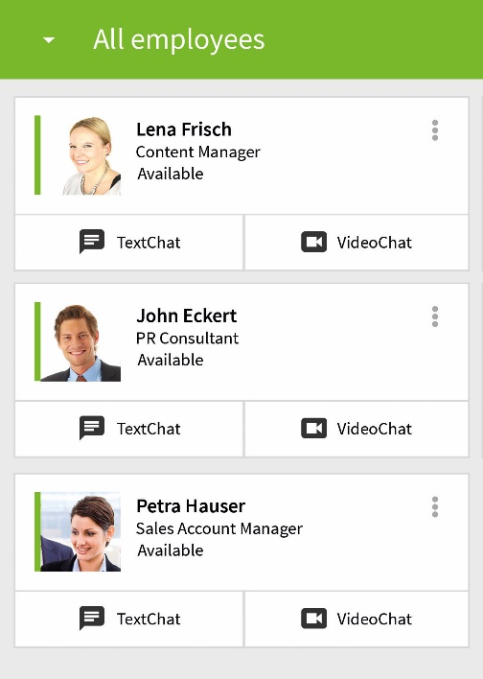
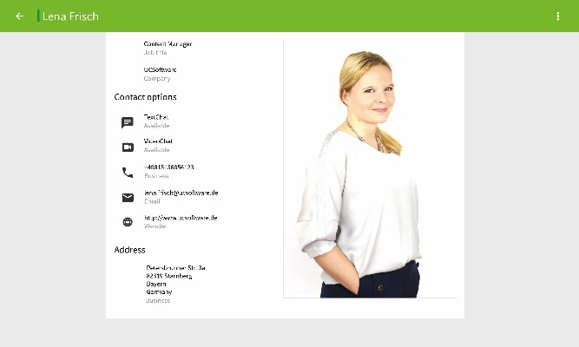
ProCall 6 Enterprise Software Suite (contact portal/business card)
CTI per smartphones e cellulari con supporto bluetooth
Instant Messaging
Contact portal
VideoChat (WebRTC)
Collaboration (Desktop Sharing)
Finestra di conversazione (CTI)
Funzionalità
Softphone (SIP)
Utente in
mobilità
(App for iOS
& Android)
Biglietto da visita multimediale
Integrazione ai
processi produttivi
(CEBP)
Federation
Notes:
Here we see (on the right) the two most important innovations in ProCall 6 Enterprise for real-time communication over the internet:
-Contact portal
-Multimedia business card
Contact portal: Here, a website visitor sees all the employees of a company that are accessible to people "outside“, with their current contact and presence information
Multimedia business card: Below is an example of the multimedia business card. As well as a picture of the "owner", the respective contact options and the availability status are displayed here

Slide 19
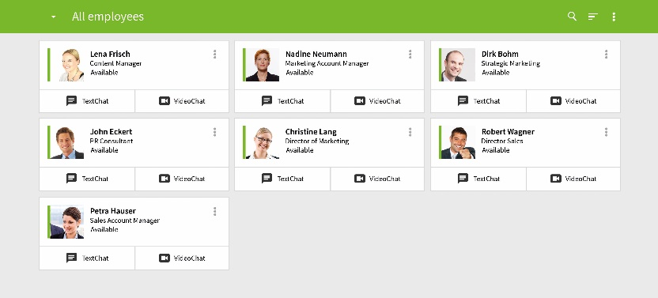

Tutto quello che ti serve per comunicare via Internet
Contact Portal
Multimedia Business Card
ProCall 6 Enterprise
Notes:
In summary, estos offers two products that companies can use to communicate over the internet:
ProCall Enterprise includes the possibilities of the contact portal and the multimedia business card. If a company also wants to offer the possibility to directly contact an employee, for example, on a specific product page of the website, then the product LiveChat 2 offers this. In this case, a suitable contact person with availability and contact possibilities is displayed as a widget on the product page. LiveChat 2 is currently still in the test phase. If you know a company interested in the widget function or if you have any further questions, just contact us personally. The contact information can be found on the last slide of this presentation.

Slide 20
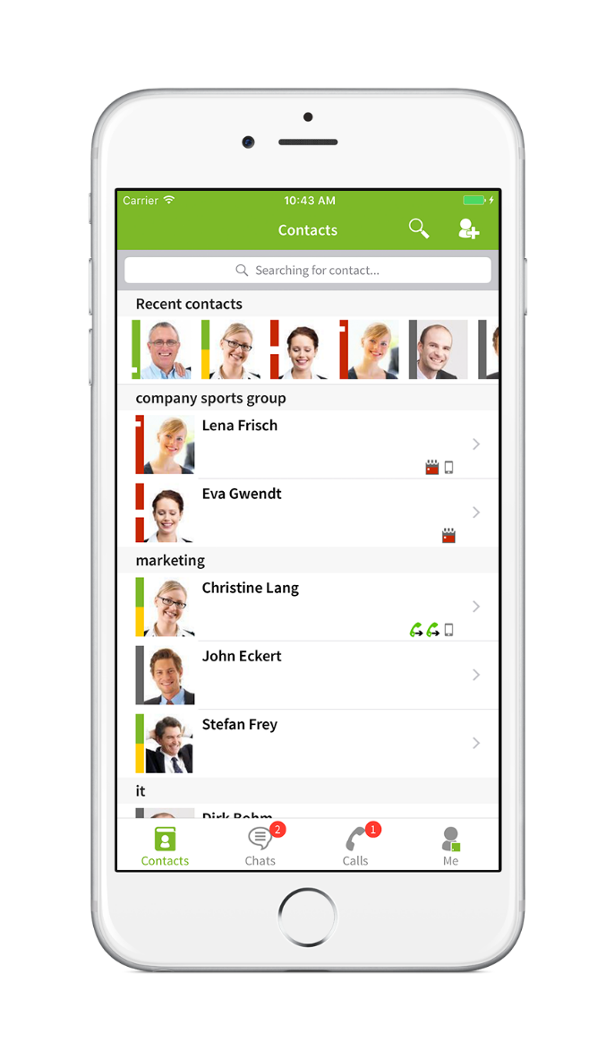

Nuove app per iOS & Android
Funzionalità Softphone SIP e controllo CTI
Journal delle chiamate sempre sincronizzato
Ricerca e risoluzione su chiamata in ingresso
es. contatti provenienti da CRM o ERP
Instant messaging e presence management, incl. Federation
Audio/video chat basata su WebRTC
Configurazione immediata con ProCall Mobility Services (optional) (powered by UCConnect)
Notes:
The previous app from ProCall 5 Enterprise has been completely revised:
The new native smartphone app is called ProCall6 Mobile and can be installed from the Apple iTunes and Google Play Store
The extensions include the softphone function (SIP), which can also be used in the smartphone app
You are connected to the smartphone app as a SIP/VoIP or CTI extension to your telephone system
The SIP/VoIP/CTI telephone journal extension is also on the app. The journal of your smartphone is not synchronized, since this is technically inhibited on the smartphone platforms. If you wish, however, you can synchronize the mobile journal via the Bluetooth connection with your PC/laptop and the Windows desktop client, comparable to the hands-free system in a car
Access to contact information sources in the company also allows you to access the contact details from the outside, without having to synchronize/copy them to the smartphone
Instant messaging and presence management also functions across the company's borders via federation with customers and partners. This allows you to easily exchange text messages and presence information
An audio/video chat to ProCall Enterprise Clients is possible
To use the smartphone apps, you need to set up the company's IT infrastructure so that the apps can connect to the UCServer of ProCall Enterprise (HTTPS reverse proxy in the DMZ). If you do not want this or if you can not change the IT infrastructure, the ProCall Mobility Services is a hybrid cloud module. This significantly reduces, among other things, the need for changes in the IT infrastructure and normally works immediately. ProCall Mobility Services can also be tested for a period of 45 days, free of charge and with a shortened registration

Slide 21
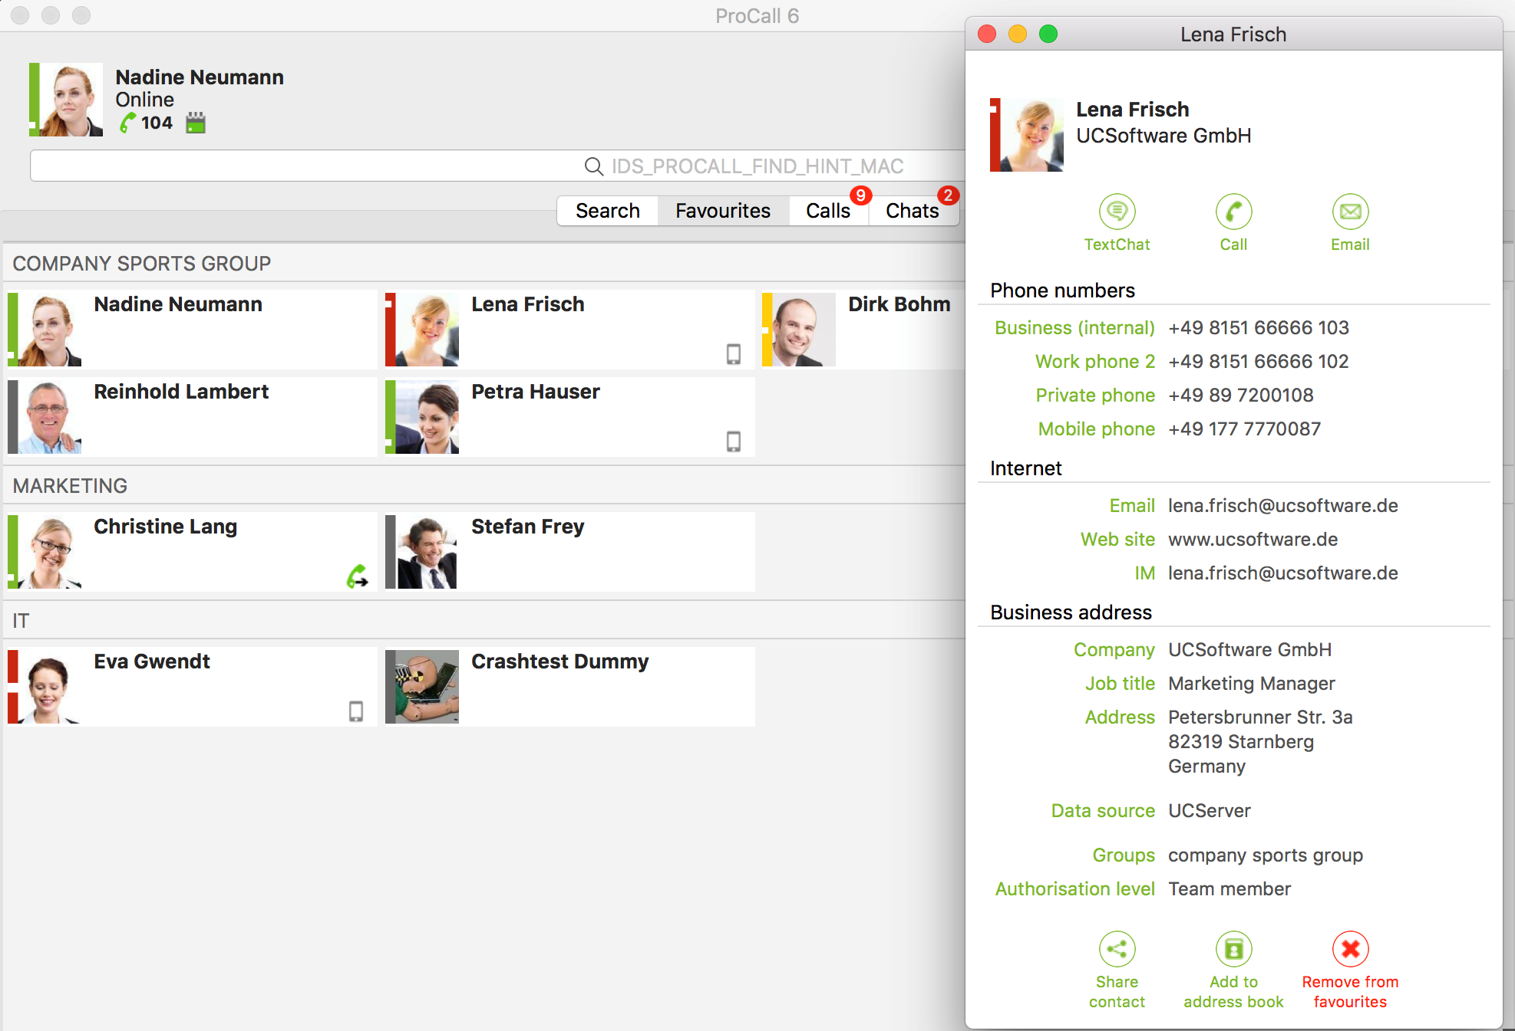
Mac client: Funzionalità consolidate e ridisegnate
Controllo telefonico ( CTI )
Instant messaging e presence management, incl. Federation
Integrazione ai principali CRM, ERP e software gestionali. Le informazioni più rilevanti sono immediatamente disponibili.
Ricerca e risoluzione nomi per chiamate in uscita/ingresso
Nuova e moderna UI con usabilità migliorata
Configurazione immediata grazie ai ProCall Mobility Services (optional) (powered by UCConnect)
Notes:
The Mac client from ProCall 5 Enterprise has also been completely revised:
The main focus of the Mac client are CTI functions
You can also have integration of contact data sources with the phone number or search
Of course, you also have a journal and a chat function
The completely revised user interface is new

Slide 22
API server side
API lato UCServer per l’integrazione con il mondo terze parti
API RESTful standard per fornire, tramite webservices, le seguenti funzioni ad applicazioni di terze parti:
Controllo del dispositivo telefonico (chiamata, riaggancio, etc)
Fetch e push informazioni di presence
Qualsiasi applicazione terza sarà in grado, quindi, di interagire con le funzioni UC&CTI di ProCall Enterprise senza utilizzare applicativi client.
Previsto un licensing per infrastruttura senza client ProCall Enterprise (UCServer TAPI Lines)

Slide 23
Requisiti di sistema (5-2500 utenti per server)
Server
Windows Server 2016
Windows Server 2012 R2
Windows Server 2012
Windows Server 2008 R2 Service Pack 1
Windows Client
Windows 10
Windows 8.1
Windows 7 Service Pack 1
Mac Desktop
macOS Sierra 10.12
macOS El Capitan 10.11
Smartphone App
iOS 9 o superiore
Android 4.1 o superiore
Notes:
New for ProCall6 Enterprise is the Windows Server 2016 support
For more details on supported systems, see the product release notes

Slide 24
Requisiti hardware
Server
Utenti attivi: 50
CPU: 4 cores, 3GHz
Memoria (RAM) disponibile: 2 GB
Spazio libero su HD: 1 GB
Network: 1 Gbit/s
Workstation Windows
CPU: 2 cores, 2GHz
Memoria (RAM) disponibile: 150 MB
Spazio libero su HD: 500 MB
Network: 100 Mbit/s
Notes:
This recommendation for system requirements is for installations where 50 users are active at the same time. For example, if they are conducting telephone conversations, using audio/video chats or searching for contact information sources, the installation can then be larger.

Slide 25
Licensing
Semplice e veloce: 1 licenza utente per tutti i servizi
(pacchetti combinabili tra loro a partire da 5 utenti)
Ipotesi 5 utenti: € 200,00/utente (incl. MetaDirectory 4)*
*esclusi ECSTA in base al progetto

Slide 26

Hybrid Cloud building blocks
Notes:
Let's go to the next topic – UCConnect. What is this? UCConnect is the umbrella term for different building blocks that estos offers for a hybrid cloud. These bundled services are intended to facilitate the commissioning of various functions of estos software products, such as the use of the ProCall mobile app or communication via the company website.

Slide 27
Vantaggi dei nostri servizi online
Facilitano la configurazione delle applicazioni Unified Communications
Riducono drasticamente la necessità di modifiche all’infrastruttura di rete
Permettono l’uso dei servizi esterni (accesso mobile, Contact Portal) senza know-how IT specifico
Sicurezza allo stato dell’arte
Controllo e supervisione
Notes:
The supplementary online services are an alternative for companies that do not have the staff resources or the technical know-how to set up more complex functions, such as the use of ProCall Mobile from the internet, or set up communication possibilities via their website. The supplementary online services significantly simplify the commissioning of some functionalities and the customer does not have to worry about anything else. In essence, see the list below.

Slide 28








Componenti Hybrid Cloud come servizi addizionali
ProCall
Web Communication Services
ProCall
Mobility Services
Portale contatti via web
Accessibilità tramite web
Comunicazione Web Audio/video
Lavoro in mobilità
Home Office
Comunicazione Audio/video
Notes:
Basically, estos distinguishes between ProCall Web Communication Services and ProCall Mobility Services.
This includes the user profile on the website, i.e. the multimedia business card, the availability via the website, i.e. the contact portal, are made visible to selected ‘external’ company employees as well as the respective audio/video chat function.
The ProCall Mobility Services facilitate the external use of the ProCall client so that a user can be reached optimally via ProCall Mobile, even when working from home or on the road, and has, for example, access to valuable contact data.

Slide 29

ProCall Web Communication Services
Per l’uso di Contact Portal e biglietti da visita multimediali
Notes:
Let us take a closer look at the ProCall Web Communication Services. They are aimed at companies that want to use the multimedia business card and the contact portal.

Slide 30
ProCall Web Communication Services
Semplifica il setup delle meccaniche di Comunicazione via Web
  Contact portal e biglietto da visita multimediale
    Disponibile tramite il Cloud estos presso https://call.ucconnect.de
    Per il vostro dominio, con il vostro URL
  Comunicazione Audio/video verso tutti i client ProCall Enterprise
Licensing a pacchetto
  Diverse “taglie” (S, M or L) in base al numero di chiamate previste
  Durata temporale (12 mesi)
Obiettivi del servizio
  Una quantità ben definita di visite uniche dalla pagina Contact Portal e biglietto da visita multimediale
  Quantitativo disponibile di ore di videocomunicazione (quota video per mese)
  Il quantitativo è condiviso tra tutti gli utenti ProCall Enterprise
Notes:
There are two ways to use the contact portal or the multimedia business card.
On the one hand, through estos cloud via call.ucconnect.de or via your own company website with your own https URL. Licensing is package-based. estos currently offers three selectable packages S/M/L, each valid for 12 months. The package scope depends on the number of unique website calls. These figures can usually supply the marketing, the online marketing or the agency of a company, if the company web page is maintained. What remains to be considered is the fact that a company acquires a certain total quota that is shared among all ProCall Enterprise users. You can use the quota of audio/video hours until it is depleted.

Slide 31
Modalità
Test
Gratuita
45 giorni
25 utenti e pacchetto L
Breve registrazione sul portale UCConnect (azienda, nome, e-mail)
Nessun contratto
Licenziata
Seriale da attivare
Durata 12 mesi (dall’attivazione)
Pacchetto selezionato
Registrazione completa sul portale UCConnect
Nessun rinnovo automatico
Rinnovo possibile solo in congiunzione con la più recente release di ProCall Enterprise
Notes:
There are two types of services. On the one hand, the services can be tested free of charge for 45 days. The test operation includes 25 users and applies to the L package. For testing, only a shortened registration is necessary with details of company, name and e-mail. There is no binding contract.
An activation key is then required. This is valid for 12 months from the time of activation and covers the selected users or the selected package. It is important that there is no automatic extension of the runtime. An extension is only valid in conjunction with the current product version.

Slide 32
Prezzi listino ITA
ProCall Web Communication Services (12 Months)
1334000100 | S Packet | 150 definite views/month | € 468,00
 |  | 20 hours of video communication/month
1334000200 | M Packet | 750 definite views/month | € 2.340,00
 |  | 100 hours of video communication/month
1334000300 | L Packet | 1500 definite views/month | € 4.680,00
 |  | 200 hours of video communication/month
Notes:
Here you can see an example of the price range as a company. Important: We are talking about end-consumer prices. As mentioned, the site's unique web page calls are available to the department or agency that manages the company's website. estos recommends the M package due to experience gained so far. A downgrade or upgrade is possible at any time after expiry of the 12 months.

Slide 33

ProCall Mobility Services
Per l’uso di ProCall Enterprise in mobilità
Notes:
Let's take a closer look at ProCall Mobility Services.

Slide 34
ProCall Mobility Services
Semplifica il setup delle seguenti funzioni, al di fuori della rete aziendale
  ProCall 6 Mobile
  Comunicazione Audio/Video per tutti i client ProCall. Es. funzionalità Softphone
Licensing User-based
  In base al numero di utenti che si vuole abilitare al servizio
  Durata limitata (12 mesi)
Obiettivi del servizio
  Uso illimitato delle funzioni standard (journal, chat, softphone, etc)
  Uso limitato della videocomunicazione WebRTC (per utente per mese)
  La quota è condivisa tra tutti gli utenti ProCall Enterprise
Notes:
The ProCall Mobility Services are intended for company employees who do not want to dispense with their ProCall functions even when they are on the move, and therefore decide to use the ProCall mobile app. ProCall 6 Mobile gives users the ability to run audio/video chats even when they're on the move. The ProCall Mobility Services require user-based licensing, meaning a company needs exactly as many licenses as users of the app. The contract runs for 12 months again. The quota for audio/video communication is distributed among the users, as in ProCall Communication Services.

Slide 35
Modalità
Test
Gratuita
45 giorni
25 utenti e pacchetto L
Breve registrazione sul portale UCConnect (azienda, nome, e-mail)
Nessun contratto
Productive mode
Seriale da attivare
Durata 12 mesi (dall’attivazione)
Pacchetto selezionato
Registrazione completa sul portale UCConnect
Nessun rinnovo automatico
Rinnovo possibile solo in congiunzione con la più recente release di ProCall Enterprise
Notes:
There are two types of services. On the one hand, the services can be tested free of charge for 45 days. The test operation includes 25 users and applies to the L package. For testing, only a shortened registration is necessary with details of company, name and e-mail. There is no binding contract.
An activation key is then required. This is valid for 12 months from the time of activation and covers the selected users or the selected package. It is important that there is no automatic extension of the runtime. An extension is only valid in conjunction with the current product version.

Slide 36
Ordine e attivazione servizi cloud
estos
Seriale
Reseller
Seriale
End user-companies
Servizio
Distributore
Registrazione &
Attivazione servizio
Conferma
UCConnect
Portal
Agreement
Notes:
As mentioned above, an activation key is required for productive operation. Ordering the activation key for online services works basically just like the purchase of software licenses. The activation key can be ordered either directly through estos or via the usual distribution channels. Upon receipt of the activation key, the latter must be activated either by the end-user company or by the retailer on behalf of the end-user company (service activation). This requires registration and thus an account in the estos UCConnect portal.

Slide 37
Protezione dei dati
Server posizionati all’interno dell’Unione Europea
Gestione dei dati in accordo al recente regolamento europeo sulla privacy (GPDR)
  Il servizio è utilizzato per l’interscambio di dati (personali) tra client e server
  Obbligo legale per entrambe le parti alla sottoscrizione di un Agreement
  Agreement viene fornito all’attivazione del servizio
Notes:
Of course, the topic of data protection is also important for hybrid cloud modules. Therefore, all servers used have a location within the European Union, which means there is no data export. The legal framework for data protection is already in line with the provisions of the German Data Protection Act (EU-DSGVO) and thus provides legal certainty. Since the services (personal data) are exchanged, order data processing agreements must be concluded between the end user companies and estos. This is done when activating the services.

Slide 38
Prezzi listino ITA
ProCall Mobility Services (12 Mesi)
1332000050 | 5 users | € 225,00
1332000100 | 10 users | € 450,00
1332000250 | 25 users | € 1.125,00
1332000500 | 50 users | € 2.250,00
1332000750 | 75 users | € 3.375,00
1332001000 | 100 users | € 4.500,00
Notes:
Here again is an example of the price range. Here, too, we speak of end-consumer prices.

Slide 39
Modalità
Test
Gratuita
45 giorni
25 utenti e pacchetto L
Breve registrazione sul portale UCConnect (azienda, nome, e-mail)
Nessun contratto
Productive mode
Seriale da attivare
Durata 12 mesi (dall’attivazione)
Pacchetto selezionato
Registrazione completa sul portale UCConnect
Nessun rinnovo automatico
Rinnovo possibile solo in congiunzione con la più recente release di ProCall Enterprise
Notes:
There are two types of services. On the one hand, the services can be tested free of charge for 45 days. The test operation includes 25 users and applies to the L package. For testing, only a shortened registration is necessary with details of company, name and e-mail. There is no binding contract.
An activation key is then required. This is valid for 12 months from the time of activation and covers the selected users or the selected package. It is important that there is no automatic extension of the runtime. An extension is only valid in conjunction with the current product version.

Slide 40

Serie ECSTA 5
Professional CTI and TAPI middleware
Notes:
Let's take a look at the new features of the fifth generation ECSTA series, the professional CTI and TAPI middleware from estos.

Slide 41




ECSTA 5
Cosa c‘è di nuovo?
Le altre piattaforme?
***Nuove*** piattaforme supportate:
  Mitel MiVoice Business Release 8.0
  TELES Voice Application Server
  Yealink SIP Phones
  Auerswald SIP Phones
  BroadSoft BroadWorks XSI
Supporto ai correnti sistemi operativi Microsoft
Perfomance migliorate
Setup e manutenzione semplificati
Interfaccia amministrativa rivisitata
Aastra 5000, Aastra MX-ONE, Aastra OpenCom 100
Alcatel OmniPCX
Avaya ACM, Avaya CS 1000
Cisco CME
Mitel MiVoice MX-ONE, Office 400
Panasonic NS-NS(X) Series
Siemens HiPath 3000
SIP Phones (snom)
Unify OpenScape 4000
Unify OpenScape Business
Unify OpenScape Voice
Notes:
The ECSTA series supports in version 5:
New platforms
The latest Microsoft operating systems
In addition to improved performance and an optimized user interface, it is simpler to set-up and launch

Slide 42


Stefano Chittaro
Account Director Expert Partner International
phone: +39 (0432) 425580
Mobile: +39 (393) 9199997
stefano.chittaro@estos.it
call.estos.it/stefano.chittaro
Daniela Sepulcri
Account Manager ITA & Int'l
phone: +39 (0432) 425578
daniela.sepulcri@estos.it
call.estos.it/daniela.sepulcri
Notes:
Contact us now!
Do you want Unified Communications, Softphone, Contact Portal or Apps? We would be pleased to inform you in more detail about our products and to discuss which options are suitable for you.

